Slide 1

Customer shopping trends analysis
Presented by
Gayatri rode

Slide 2
agenda
Introduction
Dataset
Architecture
Machine Learning
Algorithm Used in Project
Visualization
Conclusion

Slide 3

Introduction
Customer shopping Trends analysis helps in identifying patterns in shopping and identify how consumer shopping behavior has changed.
Now-a-days shopping behaviors have heavily being shifted to online. Multiple platforms are being preferred got doing online shopping. We are going to see the shopping trends of the Amazon company. It is one of the leading companies.

Slide 4
dataset
I have used Amazon Sales Dataset having around 10000 observations.
This dataset is taken from Kaggle.
Sales data provides information about the sales and products.
It tracks the patterns and predicts the trends.

Slide 5

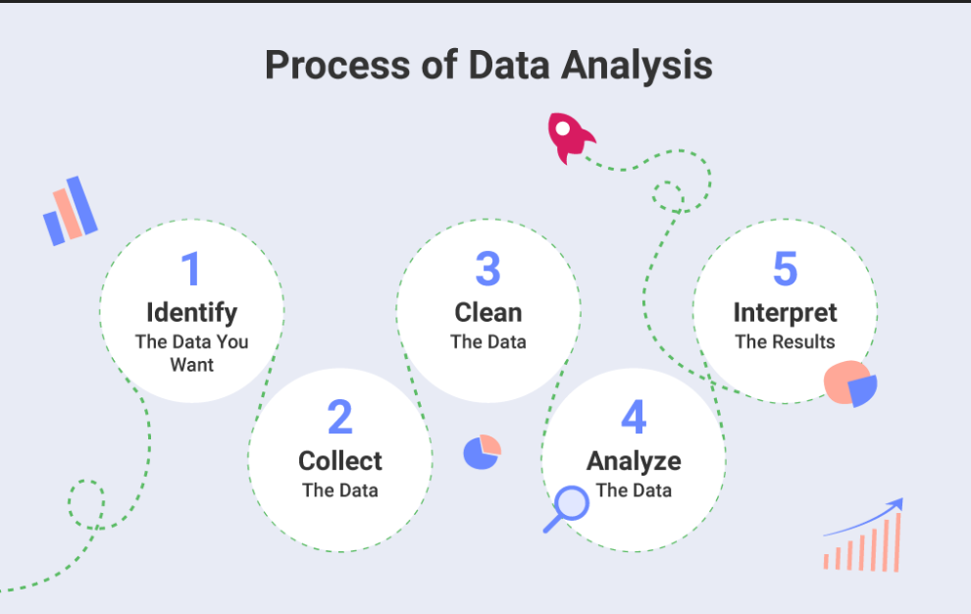
Process of Data Analsyis

Slide 6
Machine learning
Machine Learning is making the computer learn from studying data and statistics.
Machine Learning is a step into the direction of artificial intelligence (AI).
Machine Learning is a program that analyses data and learns to predict the outcome.

Slide 7
Types of machine learning
1. Supervised Machine Leaning : This type of ML involves supervision, where machines are trained on labelled datasets and enabled to predict outputs based on the provided training.
It is classified into two categories:
1. Classification
2. Regression
2. Unsupervised Machine Learning : Here, the machine is trained using an unlabelled dataset and is enabled to predict the output without any supervision.
It is classified into two types:
1. Clustering
2. Association

Slide 8
Types of machine learning
3. Semi-Supervised Machine Learning :
This is combination of supervised learning where the machine learn with a partially labelled dataset.
4. Reinforcement Machine Learning :
Here, the machine learns to preform an action from experience. It is trained using a reward – based system. If the machine performs the action correctly, it gets a reward and vice versa.

Slide 9
Algorithm Used in Project
Decision Tree Algorithm :
It is a tree-structured classifier, where internal nodes represent the features of a dataset, branches represent the decision rules and each leaf node represents the outcome.
2. Random Forest Classifier : The random-forest classification algorithm is a machine learning technique that employs learning to combine two or more machine learning models to produce a new single model. It works by training the dataset with many decision trees and then presenting the categorization modes of the various trees.
3. Logistic Regression :
This type of statistical model is often used for classification and predictive analytics. Logistic regression estimates the probability of an event occurring

Slide 10
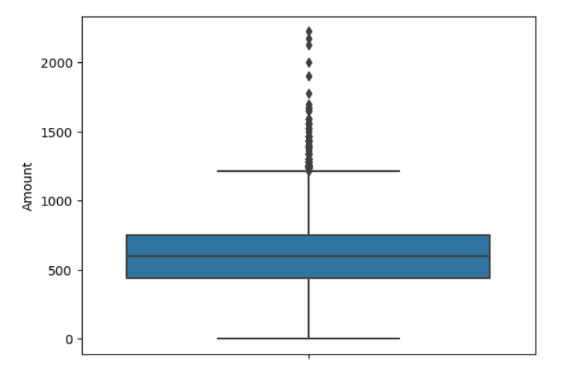
visualization

Slide 11
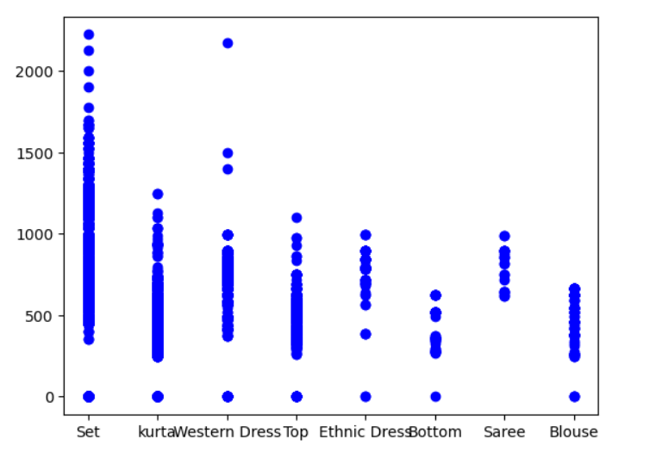
Visualization

Slide 12
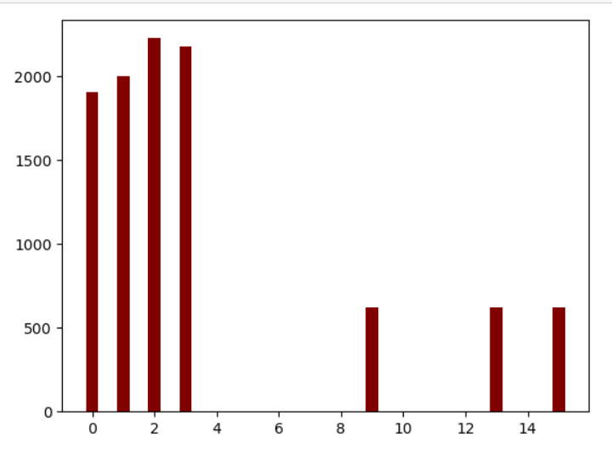
Visualization

